Slide 1

Concrete Remaining Life Prediction
Yi-Leng Chen
Feb 2, 2024

Slide 2
CONTENTS
Introduction
Equation
Goal statement
Assumption
Input and Output
Example of calculation

Slide 3
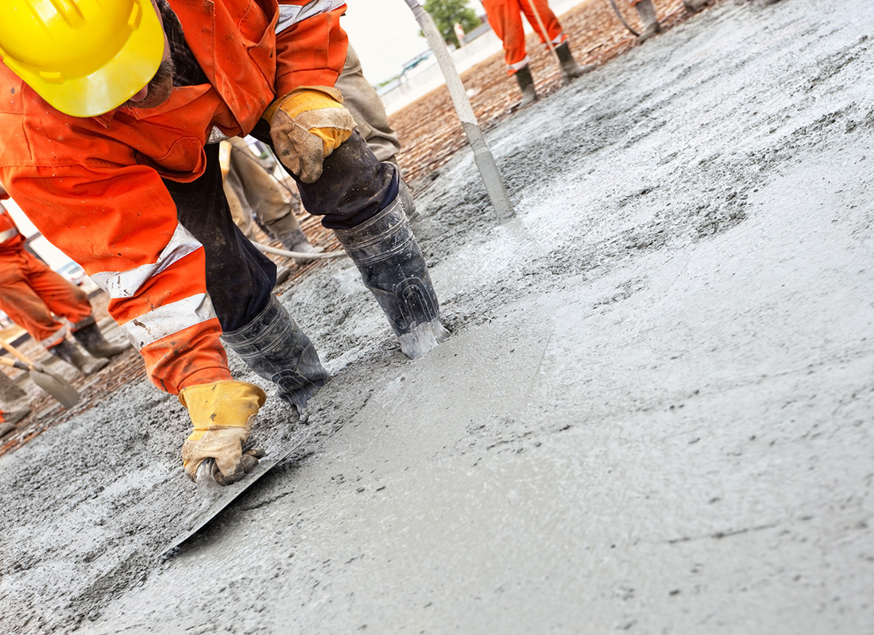
1
INTRODUCTION
In 1992, a laboratory in the United States published a paper ^{[1]} which emphasizing the importance of predicting the remaining life of concrete structures.
[1] Building and fire research laboratory. (1992). Methods for Predicting Remaining Life of Concrete in Structures.https://nvlpubs.nist.gov/nistpubs/Legacy/IR/nistir4954.pdf
[2] Avalon_Studio.(2011). Construction workers smooth the concrete stock photo [Online image].iStock.https://www.istockphoto.com/photo/construction-workers-smooth-the-concrete-gm186821913-17024671

Slide 4
2
GOAL STATEMENT
1
This project aims to develop a program that implements the theories, with the goal of predicting the remaining service life of concrete structures.

Slide 5
3
INPUT AND OUTPUT
Input
Parameters related to concrete
Output
Remaining service life of the concrete

Slide 6
EQUATION
4
Amount of concrete degradation
Rate of concrete degradation
R_{d} = n k_{d} t_{y} ^{n-1}
A_{d} = k_{d} t_{y} ^{n}
A_{d} : Accumulated deterioration at time t_{y} (years)
k_{d} : Factors influencing deterioration
t_{y} : Service life of concrete
n : Time order
R_{d} : Rate of degradation

Slide 7
EQUATION
4
Calculate the time to get failure
Remaining service life
t_{yf} = (A_{df} / k_{d})^{1/n}
t_{r} = t_{f} -t_{i}
t_{yf} : Time to failure
A_{df} : Amount of damage at failure
t_{r} : Remaining service life of concrete
t_{i} : Age of the concrete at the time of condition inspection

Slide 8
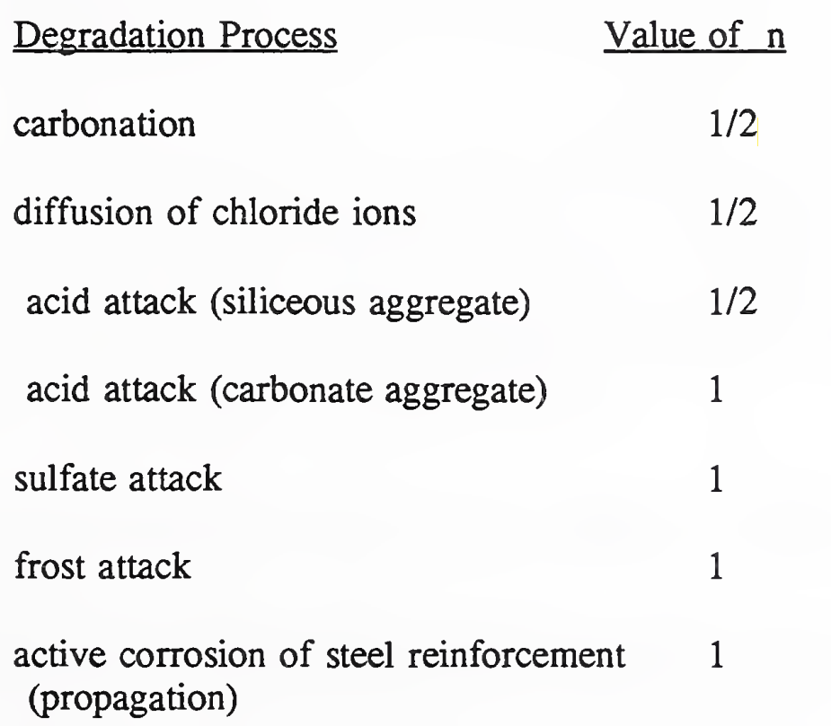
EQUATION
4
Table 1. Values of n Obtained from Models

Slide 9
ASSUMPTIONS
5
The values of k_{d} remain constant throughout the entire deterioration period.
The only factor influencing the remaining life of concrete and causing degradation is listed in Table 1.
Disregard self-conditions of concrete, such as cover thickness.
Unless specifically mentioned, consider multiple degradation processes occurring simultaneously, making the time order n=1.
If only one degradation process occurs, implicitly refer to Table 1 to determine the exact value of n.
All information obtained from inspections is accurate.
Notes:
Carbonation, sulfate attack

Slide 10
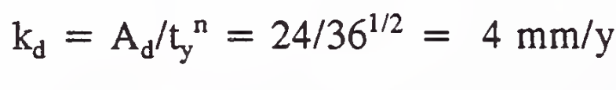
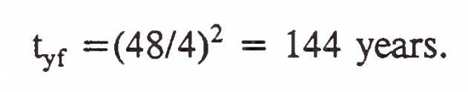
EXAMPLE OF CALCULATION
6
If the average depth of carbonation was 24 mm after 36 years and the average concrete cover over the reinforcing bars was 48 mm
144-36=108(predicted remaining service life)

Slide 11
Questions?

